Slide 1
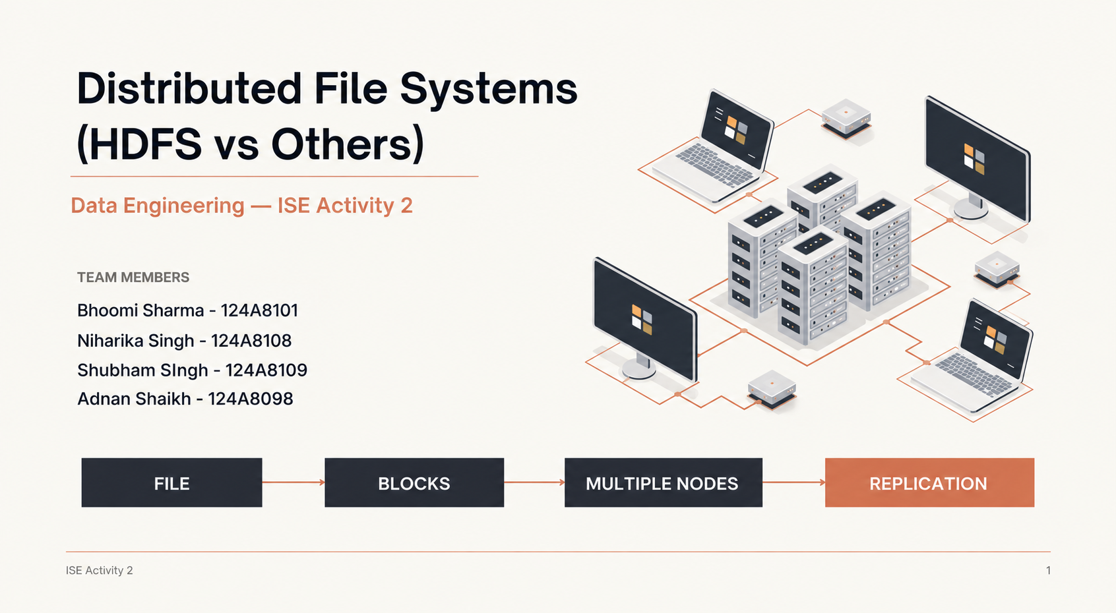

Slide 2









Case Study — When Data Outgrows a Single Server
DATA SOURCES
ILLUSTRATIVE SCENARIO — NOT A SPECIFIC COMPANY IMPLEMENTATION
MASSIVE DATA VOLUME
An e-commerce platform continuously generates:
SINGLE SERVER
Product images
CAPACITY LIMIT
Order transactions
FAILURE RISK
Clickstream logs
Customer activity
PROCESSING BOTTLENECK
DISTRIBUTED STORAGE NEEDED
Relying on one machine limits storage capacity, scalability, availability and processing throughput.
DISCUSS BEFORE MOVING TO THE SOLUTION
How can the platform store and access growing amounts of data without depending on a single machine?
ISE Activity 2
2

Slide 3
Case Study — HDFS: Distributing the Workload
HDFS SOLUTION
CLIENT
NAMENODE
metadata • namespace • block locations
DATANODE 1
DATANODE 2
DATANODE 3
physical data blocks
physical data blocks
physical data blocks
PRESENTER NOTES
• Large files are divided into blocks.
• Blocks are distributed across multiple DataNodes.
• Replication creates additional block copies.
• Replicas provide fault tolerance.
Ask: Where is the file actually stored?
The NameNode knows where the data is. The DataNodes hold the data.
ISE Activity 2
3

Slide 4
Case Study — What Actually Happens to a File?
FILE LIFECYCLE
EXAMPLE FILE
orders_2026.csv — 500 MB
01
500 MB
02
DIVIDED INTO
03
ACROSS
04
COPIES
FILE
BLOCKS
DATANODES
REPLICAS
THEN WHAT HAPPENS?
WRITE
READ
Client → NameNode
Client → NameNode
NameNode → block locations
NameNode → block locations
DataNodes → replicas
DataNodes → blocks
Write acknowledgement
Original file reconstructed
The NameNode provides metadata and block locations. DataNodes serve the actual file blocks.
ASK THE AUDIENCE BEFORE REVEALING THE ANSWER
Does the NameNode send the actual 500 MB file?
No — it sends metadata and block locations. DataNodes provide the actual data.
ISE Activity 2
4

Slide 5
Case Study — DataNode Failure and Recovery
CONTINUING THE FILE SCENARIO
BEFORE
AFTER
NORMAL STATE
AFTER DATANODE 2 FAILS
Block A → DataNode 1
DataNode 2 → FAILED
Block B → DataNode 2
Block B
Replica on another DataNode
Block C → DataNode 3
Each block also has a replica on another DataNode.
The original block is still readable.
RECOVERY PATH
01
02
03
04
05
FAILURE
DETECTED
REQUIRED BLOCK
IDENTIFIED
REPLICA USED FROM
ANOTHER DATANODE
FILE REMAINS
AVAILABLE
MISSING REPLICA
RECREATED
ASK THE AUDIENCE
DataNode 2 just failed. Did we lose the file?
No. The required block can be read from another replica.
Replication turns an individual machine failure into a recoverable event.
ISE Activity 2
5

Slide 6
HDFS vs GFS vs Amazon S3
DIMENSION
HDFS
GFS
AMAZON S3
Architecture
Distributed
file system
Distributed
file system
Object storage
service
Metadata
management
NameNode
Master server
Managed service architecture
Data unit
Blocks
Chunks
Objects
Storage model
DataNodes
Chunkservers
Buckets / objects
Fault tolerance
Replication
Replication
Managed durability mechanisms
HDFS, GFS and S3 are not identical technologies; they use different storage models.
THE COMMON IDEA
1
2
3
4
5
6
MASSIVE
DATA
DISTRIBUTED
STORAGE
REPLICATION
FAULT
TOLERANCE
SCALABILITY
LARGE-SCALE PROCESSING
HDFS is well suited to large-scale, high-throughput distributed file storage and cluster-based processing.

Slide 7
Case Study — Why E-Commerce Needs Data Quality
THE BUSINESS PROBLEM
WHAT GOES WRONG IN ORDER DATA
THE CHAIN REACTION
NEGATIVE PRICE
Revenue and margin reports are wrong
BAD DATA
DUPLICATE ORDER ID
Orders are counted twice in sales totals
WRONG REPORTS
MISSING CUSTOMER ID
Orders cannot be linked to a customer
WRONG DECISIONS
INVALID STATUS
Fulfilment and cancellation tracking break
LOST REVENUE AND TRUST
WHAT THIS PROJECT DOES ABOUT IT
Define measurable rules and validate order data before it is used
Storage solves volume. Data quality makes the stored data trustworthy.
ISE Activity 2
7
Notes:
Storing data at scale (HDFS) solves capacity, not trust. If order data is wrong, every report, revenue number and decision built on it is wrong. Data quality means defining measurable rules and checking them automatically before the data is used.

Slide 8
Case Study — Implementation: The Pipeline
ARCHITECTURE — CSV TO REPORT
DATA FLOW
01
02
03
04
ORDERS CSV
DUCKDB
SODA CORE
REPORT
synthetic e-commerce data
local analytical database
runs the quality checks
PASS / FAIL results
generate_data.py
load_duckdb.py
checks.yml + soda scan
generate_report.py
TOOLS USED
Python
CSV
DuckDB
Soda Core
YAML
generates and prepares the data
stands in for incoming orders
lightweight local database
executes the data quality checks
defines the validation rules
KEY POINT
Everything runs locally
No cloud account and no Soda Cloud needed for this implementation.
ISE Activity 2
8
Notes:
Walk left to right: data is generated into a CSV, loaded into DuckDB, checked by Soda against the rules in checks.yml, and summarised in a PASS / FAIL report. Everything runs locally.

Slide 9
Case Study — Implementation: The Dataset
SAMPLE ORDERS WITH PLANTED DEFECTS
SAMPLE ROWS FROM orders.csv (6 OF 9 COLUMNS SHOWN)
WHAT WE PLANTED
order_id
customer_id
product
unit_price
quantity
status
107
order rows in the CSV
O0001
C002
Webcam
1800
1
Shipped
O0002
C048
Mouse
800
1
Pending
O0003
C003
Monitor
12000
2
Pending
100
valid orders
O9001
C999
Laptop
-65000
1
Delivered
O9002
C998
Mouse
800
0
Delivered
O9003
empty
Keyboard
1500
1
Delivered
7
planted bad rows
O9004
C997
empty
900
1
Delivered
O9005
C996
Monitor
12000
1
Unknown
5 field-level defects + 2 rows reusing order ID O0001
EVERY DEFECT SHOULD BE CAUGHT
Each planted defect maps to a rule in checks.yml
Next: how those rules are written.
ISE Activity 2
9
Notes:
orders.csv has 100 valid orders plus 7 deliberately bad rows: five field-level defects and two rows that reuse order ID O0001. The bad rows exist so the pipeline has real problems to detect.

Slide 10
Case Study — Implementation: Defining Rules
CHECKS.YML — DATA QUALITY AS CODE
checks.yml
WHAT THE 9 RULES GUARD
checks for orders:
- row_count > 0
- missing_count(order_id) = 0
- duplicate_count(order_id) = 0
- missing_count(customer_id) = 0
- missing_count(product) = 0
- missing_count(order_date) = 0
- invalid_count(status) = 0:
valid values: ["Pending", "Shipped", "Delivered", "Cancelled"]
- invalid_count(unit_price) = 0:
valid min: 0.01
- invalid_count(quantity) = 0:
valid min: 1
4
COMPLETENESS
order_id, customer_id, product, order_date
1
UNIQUENESS
order_id must not repeat
1
VALIDITY
status must be an approved value
2
RANGE
unit_price >= 0.01 and quantity >= 1
1
VOLUME
the orders table must not be empty
WHY YAML
Rules live in a readable file, not buried in code
Anyone on the team can read, review and change them.
ISE Activity 2
10
Notes:
The rules live in a plain YAML file. Each line states what healthy data must satisfy. Nine rules across five quality dimensions.

Slide 11
Case Study — Implementation: Running Soda
SODA SCAN — RESULTS
ALL 9 CHECKS
SCAN SUMMARY
PASS
row_count > 0
Volume
107
rows scanned
PASS
missing_count(order_id) = 0
Completeness
FAIL
duplicate_count(order_id) = 0
Uniqueness
3 rows
3
checks passed
FAIL
missing_count(customer_id) = 0
Completeness
1 row
FAIL
missing_count(product) = 0
Completeness
1 row
6
checks failed
PASS
missing_count(order_date) = 0
Completeness
FAIL
invalid_count(status) = 0
Validity
1 row
invalid_count(unit_price) = 0
Range
1 row
Detect and report.
The scan never changes the data.
FAIL
FAIL
invalid_count(quantity) = 0
Range
1 row
ISE Activity 2
11
Notes:
Result of the scan on 107 rows: 3 checks passed and 6 failed. The failures are expected because the bad rows were planted on purpose. Soda only detects and reports.

Slide 12
Case Study — Implementation: Failure Analysis
VALIDATION REPORT — WHAT FAILED AND WHY
EVERY FAILED RULE, WITH THE RECORD THAT BROKE IT
TWO WAYS TO VIEW IT
FAILED RULE
BAD RECORD
WHY IT FAILED
HTML REPORT
duplicate_count(order_id)
O0001 (3 rows)
Same order ID appears 3 times
validation_report.html
Summary, failed rules and the exact bad rows
missing_count(customer_id)
O9003
customer_id is empty
missing_count(product)
O9004
product is empty
invalid_count(status)
O9005
status "Unknown" is not allowed
PIPELINE UI
python app.py
invalid_count(unit_price)
O9001
unit_price is -65000
Click through each stage and expand every failed check
invalid_count(quantity)
O9002
quantity is 0
KEY LEARNING
Define measurable rules. Validate automatically.
Catch bad data before it reaches reports, analytics or decisions.
ISE Activity 2
12
Notes:
The report goes one step beyond PASS / FAIL: it lists the exact records that broke each rule, so the team knows what to fix or reject. The same view is available in the click-through pipeline UI.

